Slide 1
WE ‘May’ KNOW YOUR AGE

Slide 2
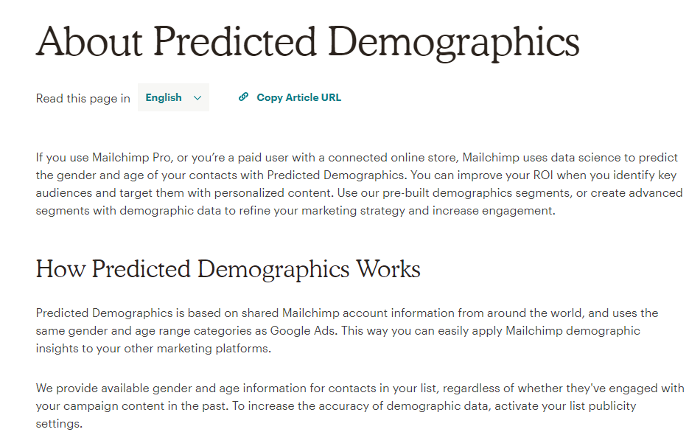
Hook
Are you passionate about animals?
Age prediction to identify target customers for marketing campaign
Age prediction based on various survey questions

Slide 3
Interesting Non-Regression Facts
Histogram of Age
For the survey questions that were rated 1-5, we treated it as quantitative variable.

Slide 4
Data Explanation
1. Participants (1010 rows) :
2. Survey Questions(150 items columns):
Music preferences (19 items)
Movie preferences (12 items)
Hobbies & interests (32 items)
Phobias (10 items)
Health habits (3 items)
Personality traits, views on life, & opinions (57 items)
Spending habits (7 items)
Demographics (10 items)

Slide 5
Quantitative & Qualitative Variables
Survey Questions(139):
I always keep my promises.:
Strongly disagree 1-2-3-4-5 Strongly agree (integer)
Categorical Questions(11):
Smoking Habits
Never smoked - Tried smoking - Former smoker - Current smoker (categorical)

Slide 6
Variable Definition
Y: Age(in demographics category)
Xs: all other 149 survey questions
Music preferences, Movie preferences, Hobbies, etc.
Intuition:
Identify correlation between Age and all other survey questions
Build regression models to predict age

Slide 7
Josh’s Intuition
The interpretation of the distribution of any particular question is:
Large percentage of responses = “3” means overall weak opinion of the question
Only include survey questions that have less than 20% of the responders choose “3”.
A survey question’s distribution with higher variance would be indicative of clusters of responders of similar age.
Use these variables, along with all qualitative and quantitative survey questions to predict Age via regression.

Slide 8
Josh’s Methodology
Filter variables if less than 200 survey takers answered “3”
Variables reduced from 149 to 50.
Stepwise Algorithm to detect significant variables
Variables reduced from 50 to 10.
Brute Force Algorithm to discover optimal solutions
Prediction: 9 Variable Model: R²_{jack} = 0.4704
Descriptive: 10 Variable Model: R²_{adjusted} = 0.4810
AIC: 10 Variable Model: AIC = 4102.3267

Slide 9
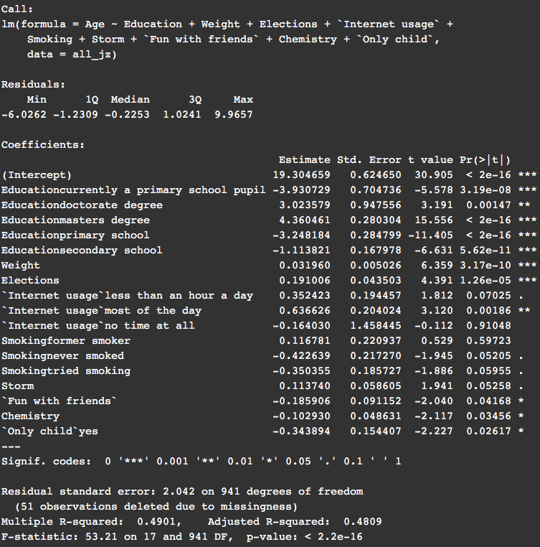
Interpretations
Note:
Unless eloquated below, all beta coefficients are logical by common sense.
Education seems to be very significant in determining a person’s age. This is as expected.
The coefficient for weight suggests that someone 1 year older will weigh 1/0.032 = 31.25 pounds more, which seems a little bit high.
A phobia of storms (Storm) increases with age. On the one hand, children may be scared of a storm’s ferocity, but storms could cause property damage for people who are older.
Having fun with friends is more important for younger people. A moment for the loss of innocence.

Slide 10
Stepwise V.S. Brute Force
Stepwise: (38*39)/2= 741 Seconds or 12.35 Mins
(My Mac → under 3 mins)
Brute Force: 2¹⁵⁰ = 7.1362385e+44
Take forever to finish

Slide 11
Stepwise Selection(Level 1,2)
Level 1: Included all variables, linear regression model
R²= 0.6478 R²_{a}=0.544 PRESS =3152.945 R²_{jack} = 0.3727
(Base Model, improve upon)
Level 2: Stepwise selection(38 variables selected)
R²= 0.585 R²_{a}=0.561 PRESS =3139.057 R²_{jack} = 0.4604

Slide 12
Stepwise Selection(Level 3)
Level 3: Excluded insignificant & unrelated variables(8)
& Combined Terms(2)
R²= 0.598 R²_{a}=0.5765 PRESS =3063.743 R²_{jack} = 0.5507
Terms deleted for Level 3:
Branded clothing high p value →0.086
Cheating in school high p value →0.144
Is only child → irrelevant
block of flat VS bungalow → irrelevant
Term modified for Level 3
internet usage & smoking

Slide 13
Stepwise Selection(Level 4)
Level 4: Add Interaction Terms
R²=0.599 R²_{a}=0.5760 PRESS =3085.696 R²_{jack} = 0.4525
reliable_waiting=reliable * waiting
questionnair_gadget=questionnair*gadgets
opera_gardening=opera*gardening
weight_reliable=weight * reliable

Slide 14
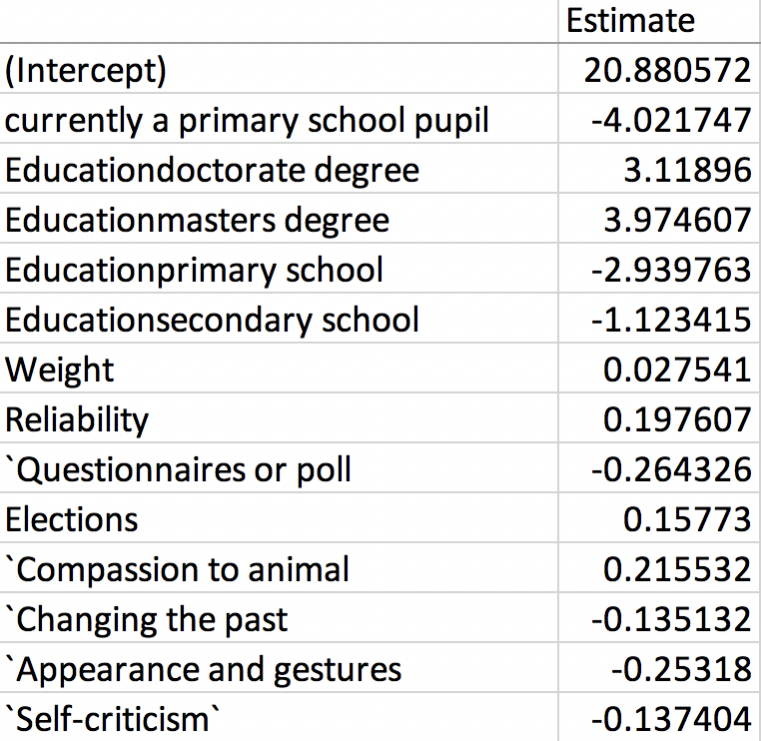
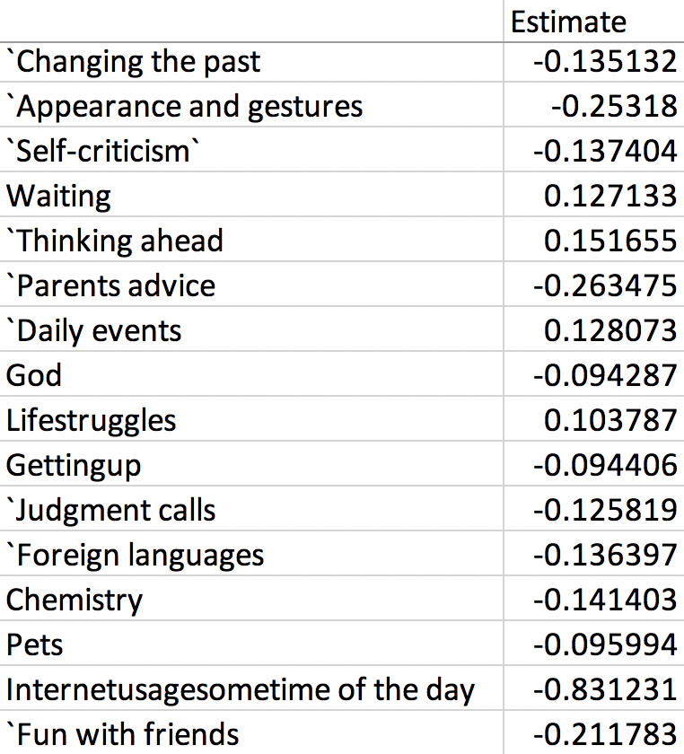
Interpretations

Slide 15
Final Model: Level 3
Level 1: R²= 0.6478 R²_{a}=0.544 PRESS =3152.945 R²_{jack} = 0.3727
Level 2: R²= 0.585 R²_{a}=0.561 PRESS =3139.057 R²_{jack} = 0.4604
Level 3: R²= 0.598 R²_{a}=0.5765 PRESS =3063.743 R²_{jack} = 0.5507
Level 4: R²=0.599 R²_{a}=0.5760 PRESS =3085.696 R²_{jack} = 0.4525

Slide 16
Conclusions and Future Work
With the goal of predicting the age and a large number of cause variables to analyze we used a combination of Brute Force and Step Wise method to identify and compare the outcomes of significant variables through Adj R², p-value and R²_{jack} .
Challenge: Brute force method involving large number of variables requires lot more computer memory.
The statistical data that was analyzed is from users in Bratislava and so the prediction may not work as expected for users in other countries with a different socio-economic culture / lifestyle. However the significant variables identified through this project will help / guide with data collection in other countries.

Slide 17
Acknowledgement
Data from Kaggle.com
https://mailchimp.com/help/about-predicted-demographics/
The data contains missing values.
All participants were of Slovakian nationality.
Age is between 15-30.

